Slide 1
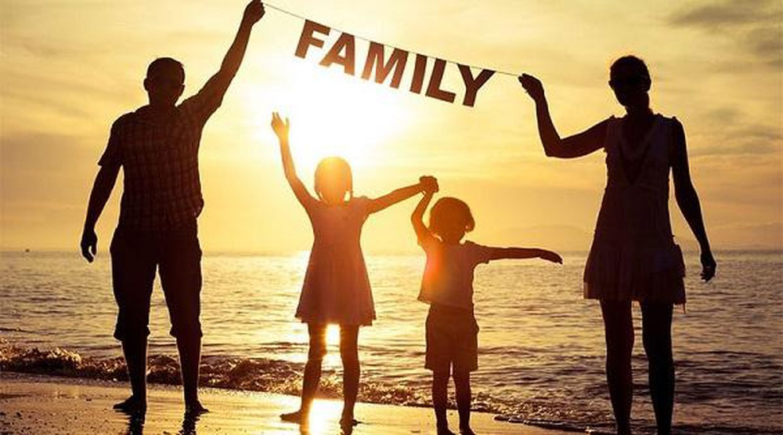
Unit 5: RELATIONSHIP
(Family)

Slide 2
I. QUESTIONS about Family
Part 1
1. Could you tell me something about your family?
2. How much time do you spend with your family?
3. Do you prefer spending time with your friends or family?
4. What do you like to do together as a family?
5. Do you get on well with your family?
6. Who are you closest to in your family?
…
Part 2
1. Describe a family member you really admire Who the person is
What this person looks like
What kind of person he/she is
and explain why you admire this person
2. Describe your best friend
Who he/she is
When you first met
Why you became friends
And say how you spend your time together
…

Slide 3
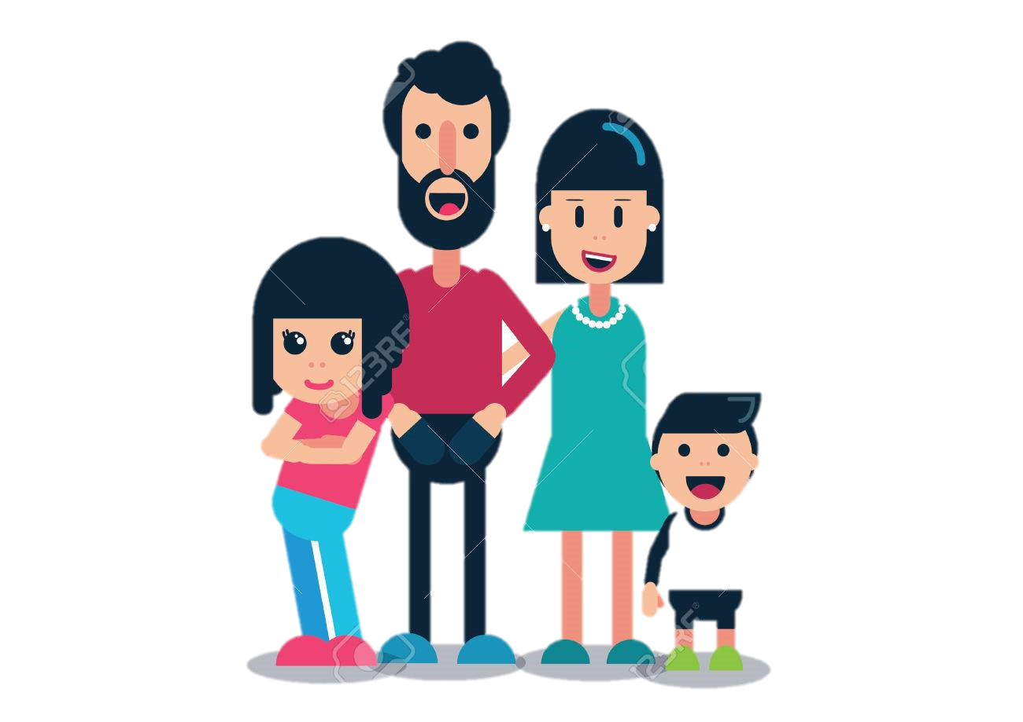
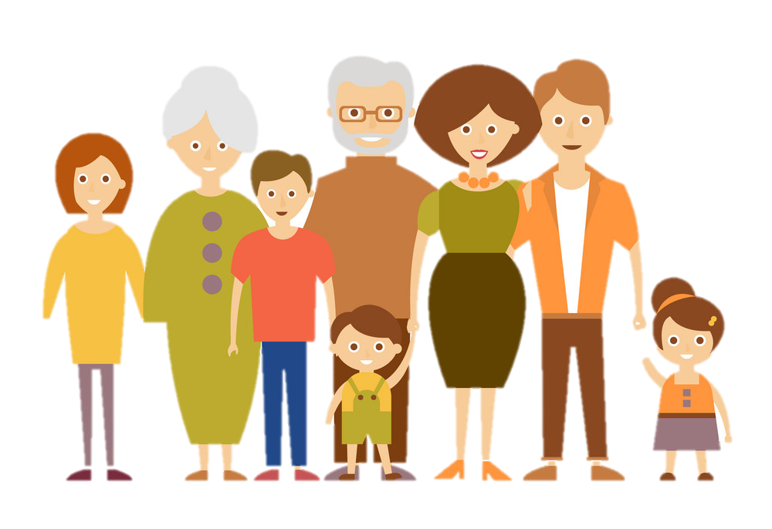
II. VOCABULARY & STRUCTURES
1. Family member
/ˈnjuːkliə(r)/
/ɪkˈstendɪd/
Nuclear family (n): Gia đình hạt nhân
(bố mẹ và con cái cùng chung sống)
Extended family (n): Gia đình nhiều thế hệ cùng chung sống

Slide 4
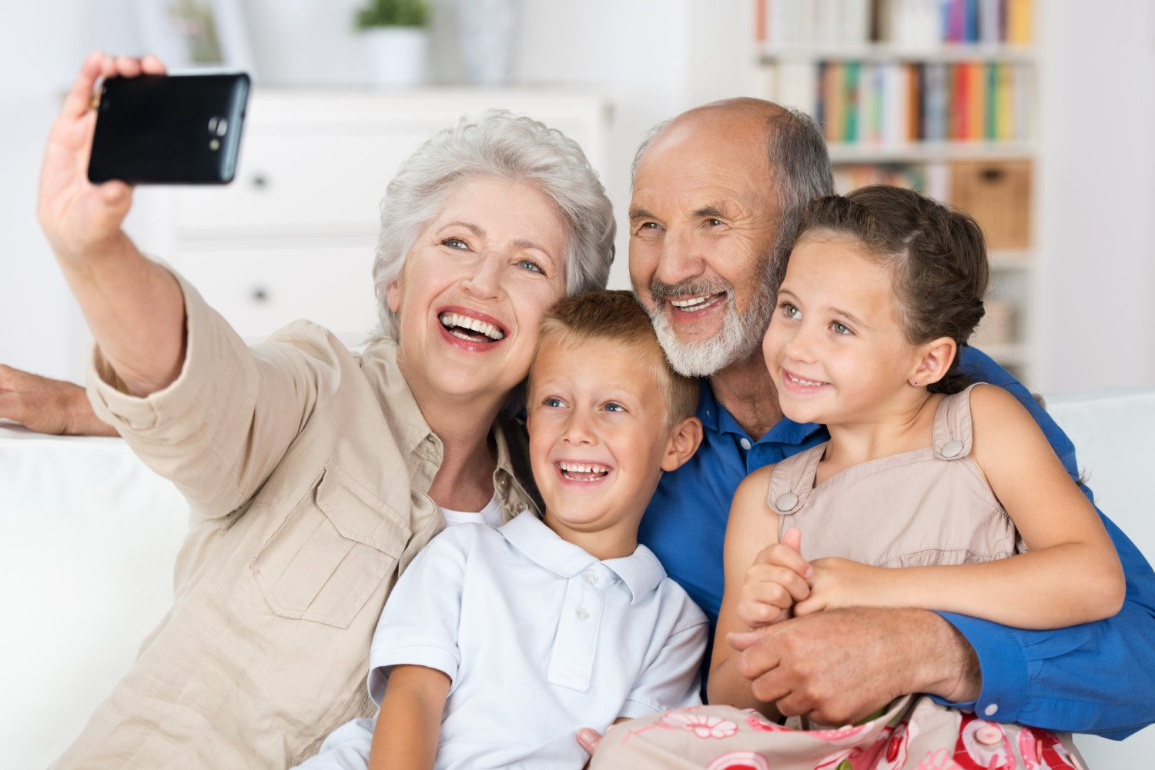
II. VOCABULARY & STRUCTURES
1. Family member
Grandmother
Grandfather
/ˈɡræn(d)peərənts/
Grandparents
Granddaughter
/'græn,dɔ:tə/
Grandson
/'grænsʌn/

Slide 5
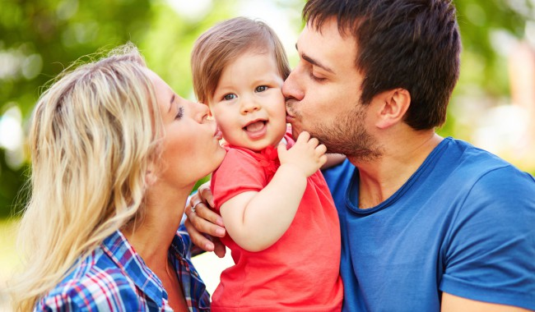
II. VOCABULARY & STRUCTURES
1. Family member
Mother
Father
/'peərənts/
Parents
/tʃaild/
/ˈtʃɪldrən/
Child → Children (số nhiều)
Son / Daughter

Slide 6

II. VOCABULARY & STRUCTURES
1. Family member
husband
/'hʌzbənd/
wife
/waif/
spouse: vợ/chồng
/spauz/

Slide 7
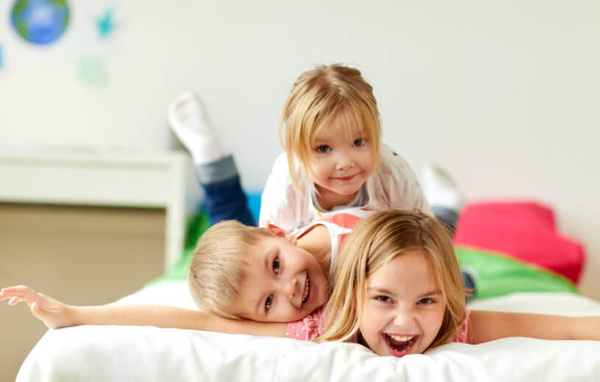
II. VOCABULARY & STRUCTURES
1. Family member
The youngest child
/ˈmɪdəl/
The middle child
/ ði ˈeldɪst/
The eldest child
/ði ‘ounli/
The only child (n): con một
/ˈsɪb.lɪŋ
Sibling (n): Anh/chị em ruột

Slide 8
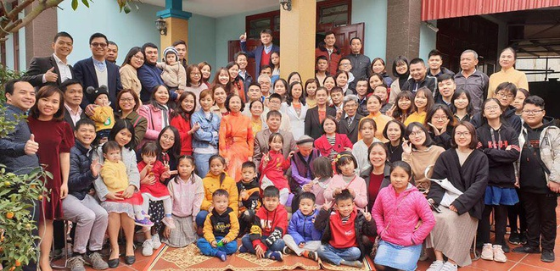
II. VOCABULARY & STRUCTURES
1. Family member
/ˈrelətɪvz/
Relatives (n): họ hàng
Close relatives
Distant relatives
/ˈdɪstənt/

Slide 9
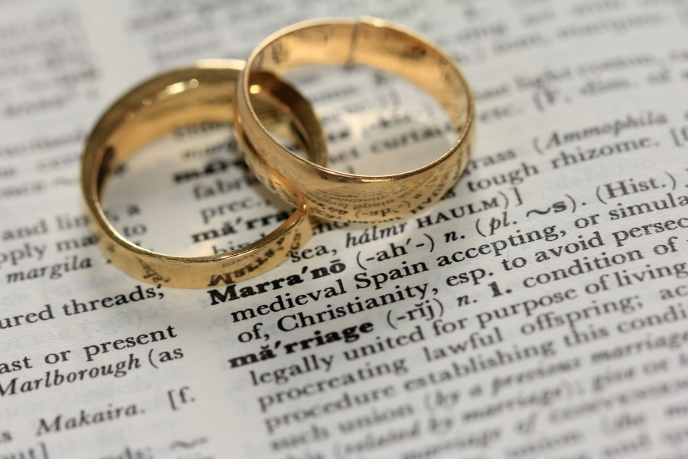

II. VOCABULARY & STRUCTURES
1. Family member
Get married to someone (v)
Expect a baby
have children
/ˈmærid/
/ɪkˈspekt/
raise/bring up children
/reɪz

Slide 10
PRACTICE
Question 1: Could you tell me something about your family?
Example 1: Well, I come from a nuclear family, which is pretty small with my parents, 1 sibling and myself. I’m the youngest child, and my brother is two years older, who’s just finishing university. I have a lot of relatives, but they live quite far away, so I don’t see them often.
Example 2: Well, I was raised in an extended family, which is pretty large with my granparents, my parents, 2 siblings and myself. We are a close-knit family, so I’m lucky to have a carefree childhood.
/ˌkləʊsˈnɪt
/ˈker.friː/
/ˈtʃaɪld.hʊd/
I live in a … , which is pretty small/large with…
come from a
was raised in a
Example 3: Well, I got married to my spouse for 5 years, and now we have got 2 kids, a daughter and a son. We are expecting our third child.

Slide 11
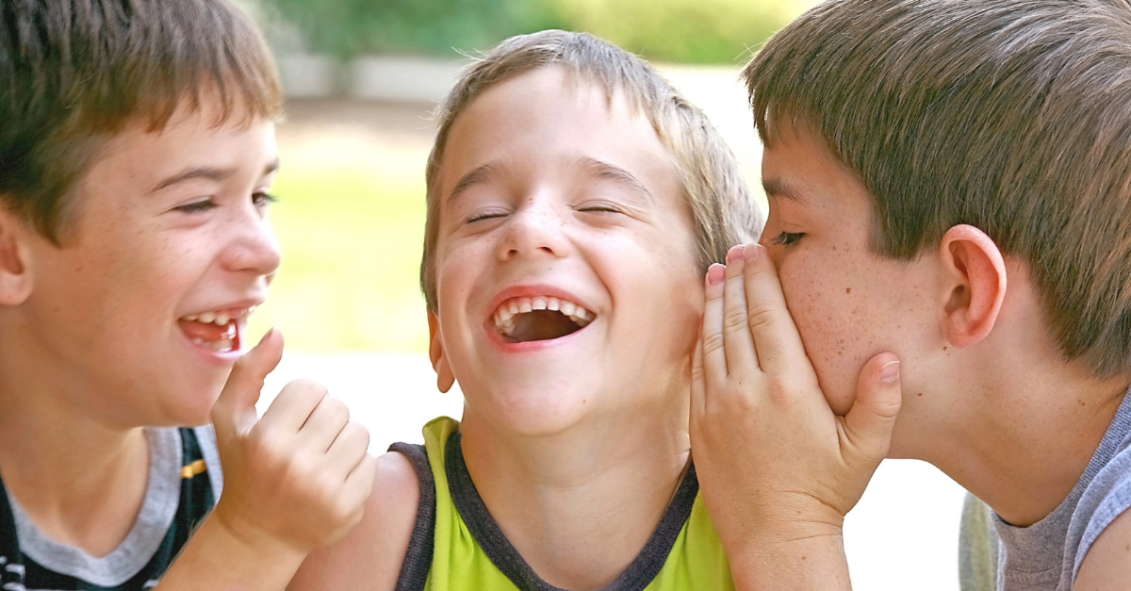
II. VOCABULARY & STRUCTURES
2. Relationship
/kləʊz/
be close to (adj): thân thiết
have a close relationship with (v)
/rɪˈleɪʃənʃɪp/
get on well with (v): hòa thuận
= get along with
/ˈkɑːmən/
have (a lot) in common (v): có điểm chung
/teɪst/
have the same tastes in (v) : có cùng sở thích
/ˈɪntrɪst/
share the common interests with (v)
see eye to eye (v): đồng quan điểm

Slide 12

II. VOCABULARY & STRUCTURES
2. Relationship
hang out for coffee (v): đi uống cafe
get together (v): gặp nhau
/ˈtʃɪt.tʃæt/
have a (little) chit-chat (v): chém gió
/ˈkwɒl.ə.ti/
spend quality time with (v): dành thời gian cho…

Slide 13

II. VOCABULARY & STRUCTURES
2. Relationship
Example: There is the generation gap between my parents and me because of age difference, so we quarrel quite often.
/eɪdʒ ˈdɪf.ər.əns/
age difference (n): sự khác biệt tuổi tác
/dʒenəˈreɪʃən ɡæp/
The generation gap (n): khoảng cách thế hệ
/ˈkwɔːr.əl/
quarrel (v): cãi cọ

Slide 14
PRACTICE
Question 2: Who are you closest to in your family?
Example 1: I have a close relationship with my sister, because we have a lot in common. We have the same tastes in fashion, music and movies. We like to get together and discuss about movies we have seen.
Example 2: I get on really well with my husband because we see eye to eye in many decisions. I always try to spend quality with him and my children to build closer family bond.
I have a good relationship with… because… We like to…
Thân thiết với ai → Vì sao → Làm gì cùng nhau)

Slide 15
PRACTICE
Question 3: Do you get on well with your family?
Example: Well not really. To be honest, I don’t have a good relationship with my parents because of generation gap. We don’t share the same ideas and opinions about many things, so we used to quarrel a lot. But now I am trying to get along with them, and talk more during family mealtime.
Yes/No? … because…
Có không? → Vì sao → Làm gì cùng nhau

Slide 16
III. HOMEWORK
Part 1
Trả lời 2 câu trong part 1
Chọn 1 đề trong Part 2 để trả lời
(Ghi âm và gửi về gmail vananhhen@gmail.com)
1. Could you tell me something about your family?
2. How much time do you spend with your family?
3. Do you prefer spending time with your friends or family?
4. What do you like to do together as a family?
5. Do you get on well with your family?
6. Who are you closest to in your family?
…
Part 2
1. Describe a family member you really admire Who the person is
What this person looks like
What kind of person he/she is
and explain why you admire this person
2. Describe your best friend
Who he/she is
When you first met
Why you became friends
And say how you spend your time together
…

